Slide 1

Dual Contrastive Learning for Unsupervised Image-to-Image Translation
Junlin Han
Joint work with Mehrdad Shoeiby, Lars Petersson, and Ali Armin
Notes:
Hi I’m Junlin from Data61-CSIRO and Australian National University, we present a new image-to-image translation model based on contrastive learning.

Slide 2
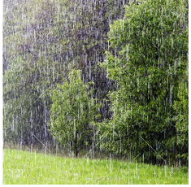
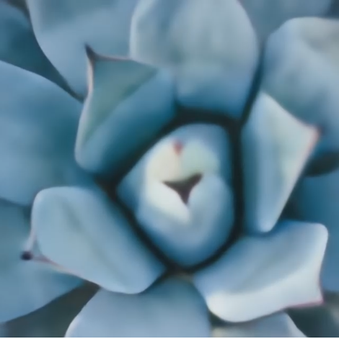
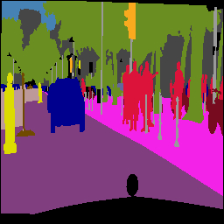
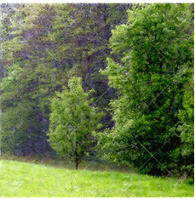
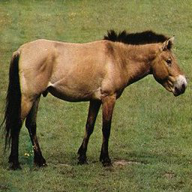
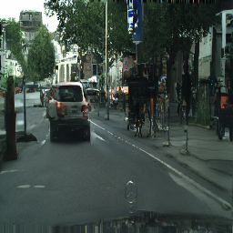
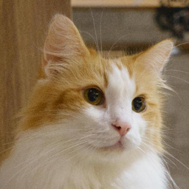
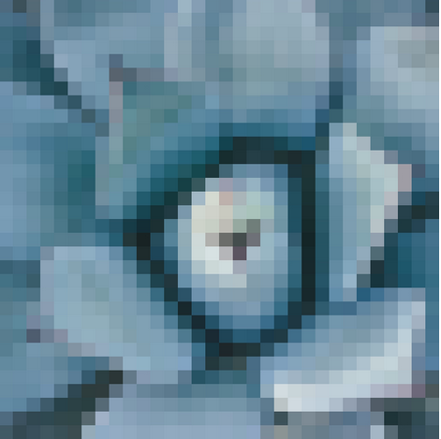
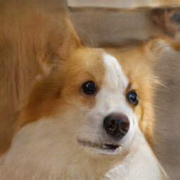
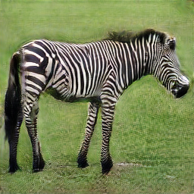
Introduction
Image-to-Image Translation
Image-to-Image (I2I) Translation.
Learn the mapping from one domain to another.
Multiple applications:
From class to class, low-res to high-res, rainy to rain-free…
Notes:
Image-to-image translation aims to learn the mapping from one domain to another. It has multiple applications, like style transfer, super resolution, and image restoration including dehazing and deraining. Some examples are shown here.

Slide 3
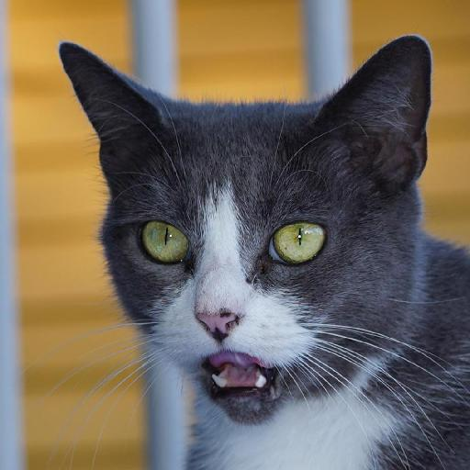
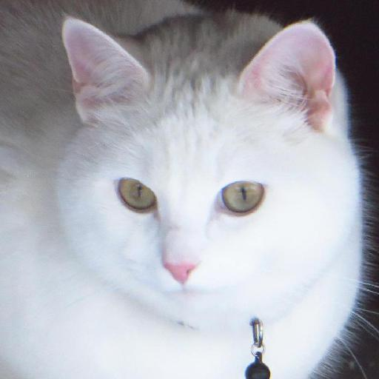
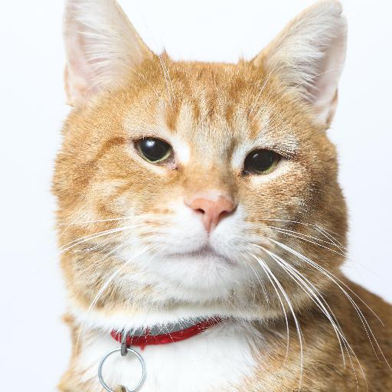
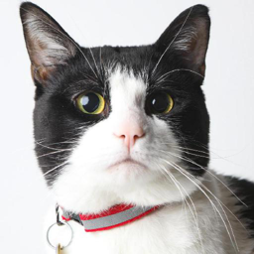
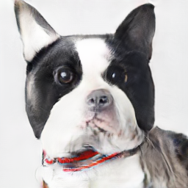
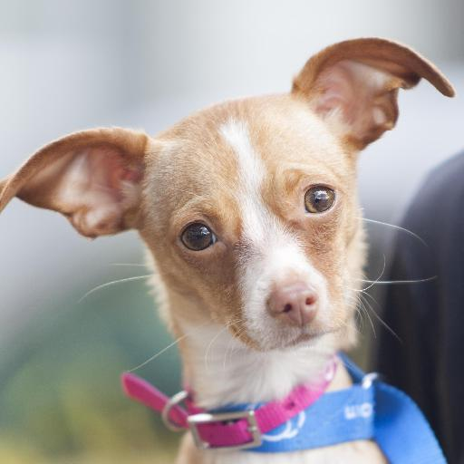
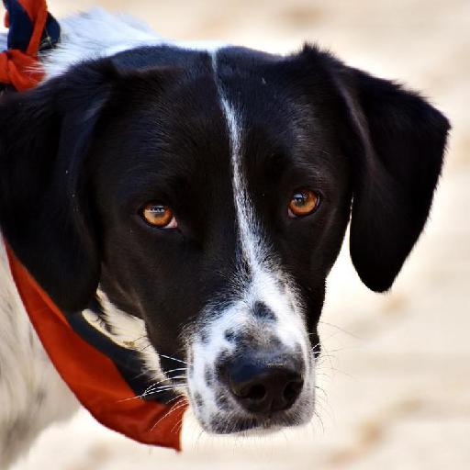
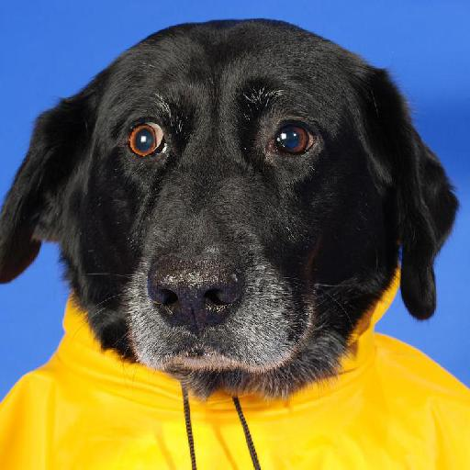


Introduction
Image-to-Image Translation
Unsupervised (Unpaired) I2I Translation.
$$⋯$$
$$⋯$$
Notes:
What is unpaired image-to-image translation? or unsupervised image-to-image translation? let's say we want to train a model that translates a cat to a dog. We can collect a dataset of cats and a dataset of dogs, but it's impossible to employ supervised training because we can not collect a pair of cat and dog with same pose background and composition. Thus, we learn the mapping from cat to dog in an unsupervised manner. like this.

Slide 4
Current Approaches
Approaches:
Limitations:
Current methods based on:
Cycle-Consistency [1]
Shared Latent Space [2]
The constrain from Cycle-Consistency is too strict.
Performance is usually limited.
[1] Zhu et al., ICCV 2017.
[2] Liu et al., NeurIPS, 2017.
Notes:
Current methods for unsupervised image-to-image translation are mainly based on two assumptions. The cycle-consistency assumption and shared lantent space assumption. They usually have some limitations and drawbacks. For example, the cycle-consistency assumption forces the input image and its reconstruction image to be identical, which is sometimes too strict. And not good at performing geometry changes.

Slide 5
New Approach
Mutual Information Maximization:
Based on recent advances in contrastive learning.
Learn the mapping by maximizing the mutual information between input and output patches, with contrastive learning.
CUT [3] first employed contrastive learning for unsupervised I2I. Our work aims to further explore how to make use of contrastive learning.
[3] Park et al., ECCV 2020.
Notes:
Recently, contrastive learning has become more and more popular in computer vision. CUT first employs contrastive learning to maximize the mutual information between input and output patches. Our work aims to further explore how to make use of contrastive learning more efficiently.

Slide 6
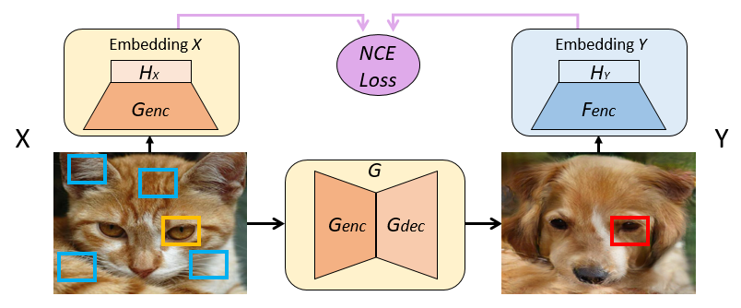
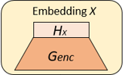
Dual Contrastive Learning
Notes:
Here is a demo of CUT. The goal of NCE loss is that given a red patch in the output image as query, we need to find its yellow positive patch with same location other than rest of the blue negative patches. CUT uses one projection head and one encoder, where the encoder is the first half of the generator to extract patch information from input image as well as the output image. Does one encoder and one projection head be able to capture the variability in two distinct domains, especially when two domains have a large gap? How about making a small change here? That is, assign a unique encoder/projection head for different domains.

Slide 7
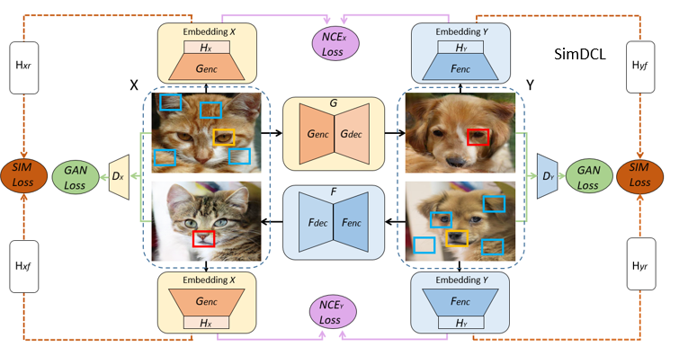
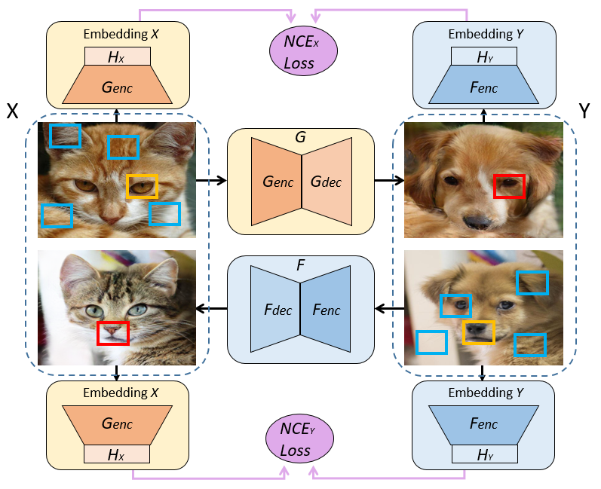
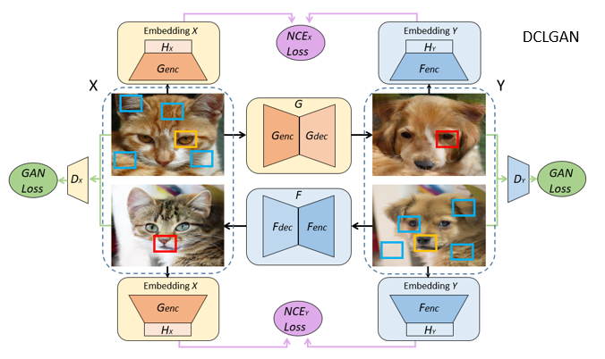
Dual Contrastive Learning
Notes:
To do so we need to add one more generator, from domain y back to domain x. Thus for different domains, we can assign its unique encoder and projection head. And we also need to add the discriminator for both X and Y domains. We name our method DCLGAN, where dcl is short for dual contrastive learning. And images inside one domain should share a similar style regardless of whether it's generated or real. Thus, we add a similarity loss to encourage images with one domain to have some similarities in deep features. We name this one as SimDCL where sim is short for similarity.

Slide 8
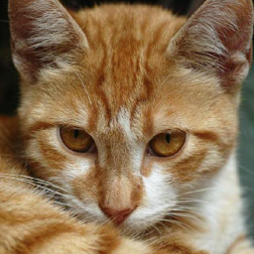
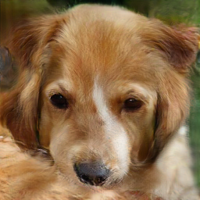
Dual Contrastive Learning
Notes:
CUT employs five levels of layers inside the encoder, that is, five different levels of patch sizes. However, CUT also includes the rgb pixel, which is the one multiply one patch. In this example the one multiply one patch of the cat is around its right ear, but after translation this part actually becomes the background. so we think rgb pixel does not beneficial to the learning process and we remove it.

Slide 9
Experiments
Datasets and evaluation protocol
Datasets: Sizes:
Horse <-> Zebra 1067 1344
Cat <-> Dog 5153 4739
CityScapes (Label -> Photo) 2975 2975
Apple <-> Orange 995 1019
Facades (Label -> Photo) 400 400
Van Gogh (Painting -> Photo) 400 6287
Evaluation protocol
Frechet Inception Distance (FID)
Intersection over Union (IoU), pixel-wise accuracy (pixAcc), and average class accuracy (classAcc) for CityScapes.
Notes:
to compare our methods with other state-of-the-art methods, we use six different datasets and they are with nine different translation directions. For metrics we mainly use the FID score, but for CityScapes we also use the IoU, pixel accuracy, and class accuracy.

Slide 10
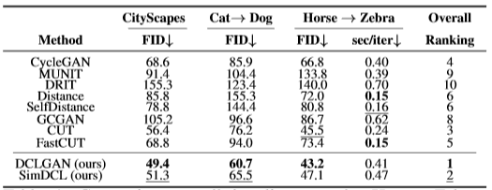
Experiments
Comparison with SOTA
Notes:
We first compare our method to 8 other state-of-the-art methods on 3 different tasks. DCLGAN achieves the best result in FID score in all three tasks, with acceptable running time. SimDCL also show good results with two tasks on the 2nd place.

Slide 11
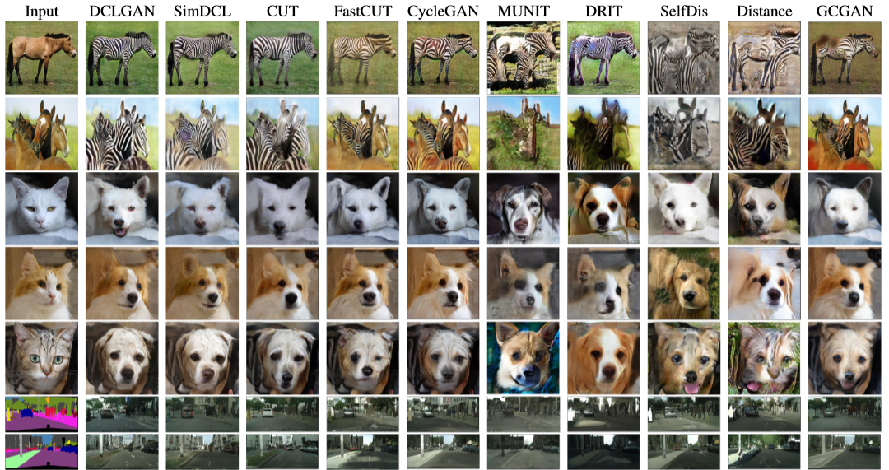
Experiments
Comparison with SOTA
Notes:
Here we show some visual examples, it's clear that DLCGAN outperforms other methods in both quantitive metrics and the qualitative results. DCLGAN is good at performing geometry changes, this is shown in the translation between cat and dog, where DCLGAN is trying to change the shape of ear and mouth to perform geometry changes.

Slide 12
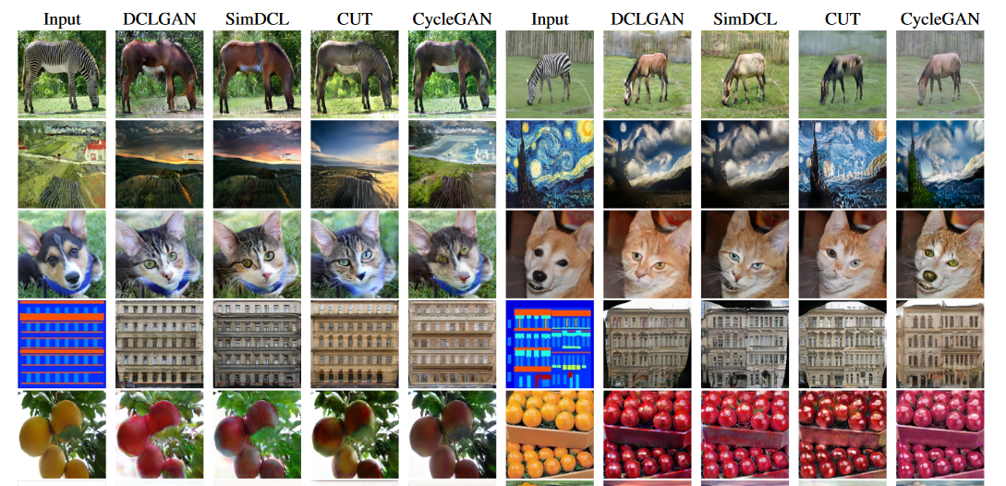
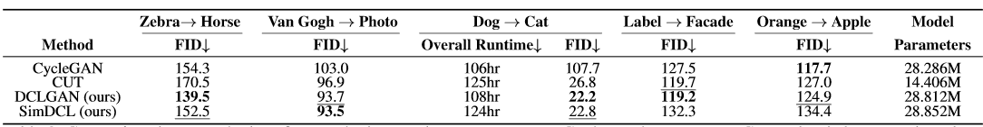
Experiments
Comparison with SOTA
Notes:
We select the best 4 methods from the last comparison on 3 tasks and conduct one more experiment. DCLGAN still consistently outperforms other methods overall. Also DCLGAN trained with 200 epochs only show the best result in dog to cat translation, better than CUT trained with 400 epochs. More visual examples are shown here, DCLGAN tends to perform a more natural translation.

Slide 13
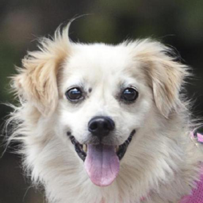
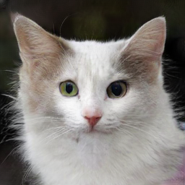
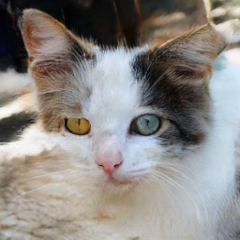
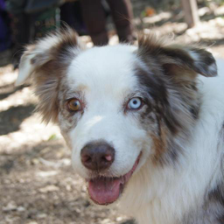
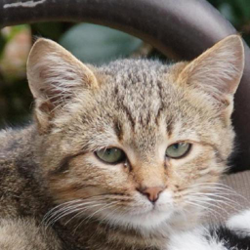
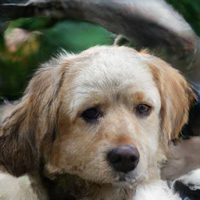
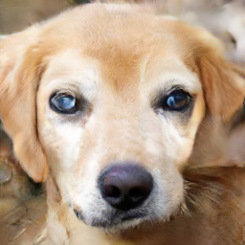
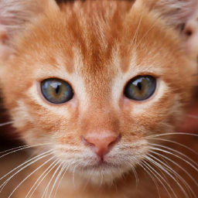
Experiments
Geometry Changes
Cat -> Dog Dog -> Cat
Notes:
DCLGAN has less constraint than CUT and CycleGAN, thus, it's good at performing geometry changes to match the distributions. Here are some examples. This property can be good if geometry changes are required.

Slide 14
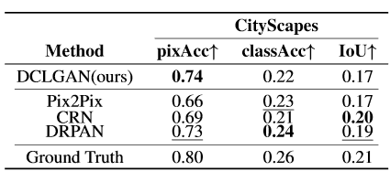
Experiments
Comparison with SOTA
Notes:
Since DCLGAN outperforms all state-of-the-art unsupervised methods. How about supervised methods . Can DCLGAN also bridge the gap between supervised methods and unsupervised methods? Just as contrastive learning in the field of representation. To explore this we conduct one more experiment with three supervised methods on the CityScape dataset. Surprisingly, we found that DCLGAN is on par with those supervised methods . This suggests that the gap is closing.

Slide 15
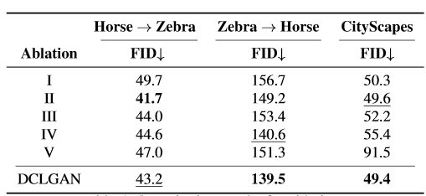
Experiments
Ablations
I : Adding RGB pixels back ( 4 layers -> 5 layers).
II : Using external negatives.
III: Using the same encoder/projection head for different domains.
IV: Adding Cycle-Consistency loss.
V : Removing the dual setting, but train one more encoder from scratch.
Notes:
For ablation study, we explore five different variants. Variant 1, 3, 5 are our main difference between CUT. We show that each component of DCLGAN is useful. For variant 2, we adds external negatives in a SimCLR style, it do show a better result than vanilla DCLGAN in horse to zebra. However, we find that objects in the generated images tend to be merged together for this variant.

Slide 16
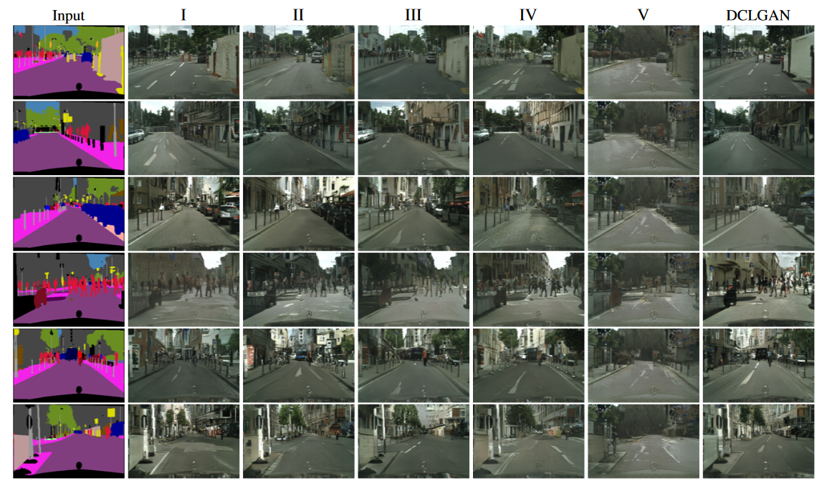
Experiments
Ablations
Notes:
here are the visual examples for all ablations, we can see that variant 2, which uses the external negatives, tends to merge objects together in the part labeled with red circle. Also the results of DCLGAN is more visually realistic than rest of them.

Slide 17
THANK YOU
Junlin Han
Junlin.Han@data61.csiro.au
Our code is available at https://github.com/JunlinHan/DCLGAN. Feel free to check it.
Notes:
Many thanks. This is all, please feel free for any questions.

